Slide 1
Software Re-Engineering
Lecture No.11
BSSE – 7 & 8
Instructor: Muhammad Usman Shahid

Slide 2
Lecture 11: Content
Source code re-engineering reference model
Code reverse engineering
Reverse engineering techniques

Slide 3
Source code re-engineering reference model

Slide 4
Source code re-engineering reference model
The Source Code Reengineering Reference Model (SCORE/RM) is useful in understanding the process of reengineering software.
The framework, depicted in Figure, consists of four kinds of elements:
function,
documentation,
repository database,
metrication.

Slide 5
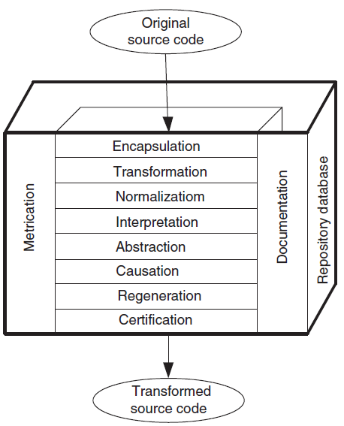

Slide 6
Source code re-engineering reference model
The function element is divided into eight layers:
encapsulation,
transformation,
normalization,
interpretation,
abstraction,
causation,
Regeneration
certification.

Slide 7
Source code re-engineering reference model
The eight layers provide a detailed approach to
(i) explaining the system to be reengineered by removing redundant data and altering the control flow
(ii) understanding the software’s requirements; and
(iii) reconstructing the software according to established practices.

Slide 8
Source code re-engineering reference model
The top six of the eight layers shown in Figure constitute a process for reverse engineering, and the bottom three layers constitute a process for forward engineering.

Slide 9
Source code re-engineering reference model
Improvements in the software as a result of reengineering are measured by means of the metrication element.
The metrication element is described in terms of the relevant software metrics before executing a layer and after executing the same layer.
The specification, constraints, and implementation details of both the old and the new versions of the software are described in the documentation element.

Slide 10
Source code re-engineering reference model
The repository database is the information store for the entire reengineering process, containing the following kinds of information: metrication, documentation and both the old and the new source codes.
The functions of the individual layers are discussed in the following:

Slide 11
Function

Slide 12
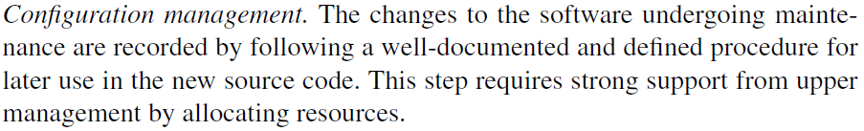
Source code re-engineering reference model
Encapsulation is the first layer of reverse engineering.
Encapsulation is a method to hide the data in a single entity or unit along with a method to protect information from outside.
The following functions are expected of this layer:

Slide 13
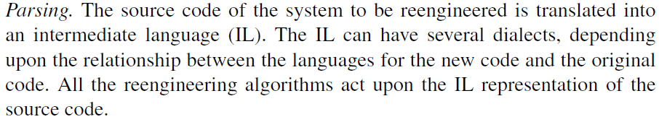
Encapsulation

Slide 14
Source code re-engineering reference model
A parser is a compiler or interpreter component that breaks data into smaller elements for easy translation into another language.
A parser takes input in the form of a sequence of tokens, interactive commands, or program instructions and breaks them up into parts that can be used by other components in programming.

Slide 15
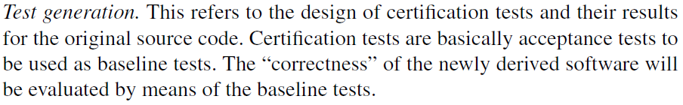
Encapsulation

Slide 17
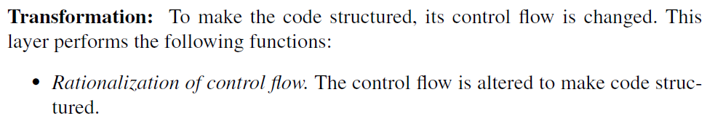
Transformation

Slide 18
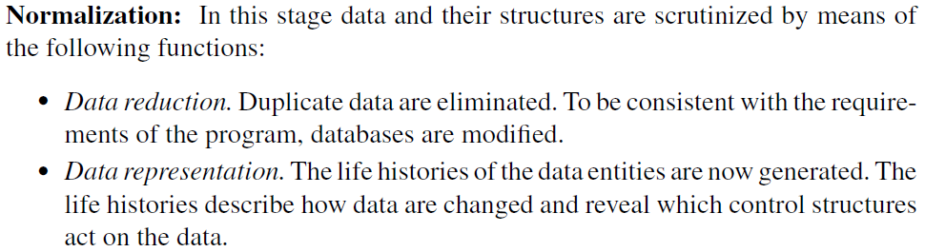
Normalization

Slide 20
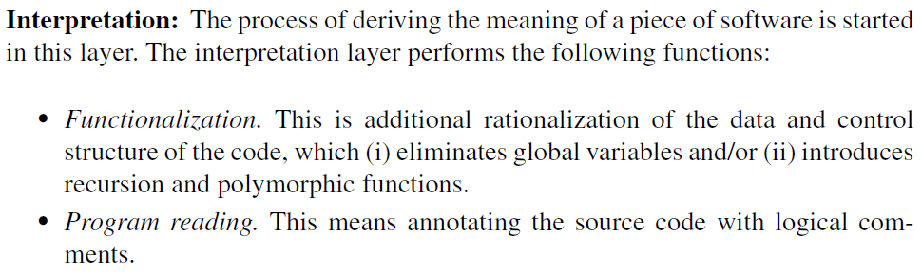
Interpretation
Notes:
recursion
The process in which a function calls itself directly or indirectly is called recursion and the corresponding function is called a recursive function

Slide 21
Abstraction
" Coupling " describes the relationships between modules,
" cohesion " describes the relationships within them.(relationship with internal features of the modules)
Abstraction is the method of hiding the unwanted information. (like driving cars)
The annotated and rationalized source code is examined by means of abstractions to identify the underlying object hierarchies.

Slide 23
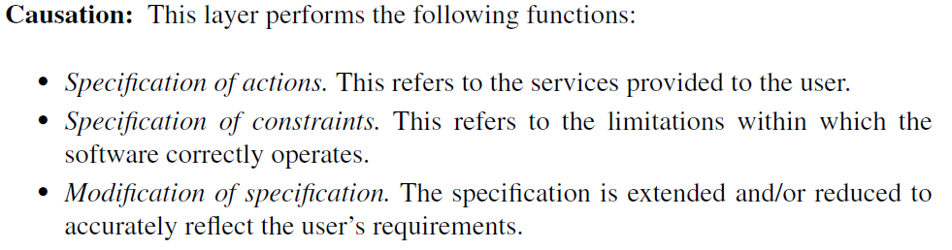
Causation

Slide 24
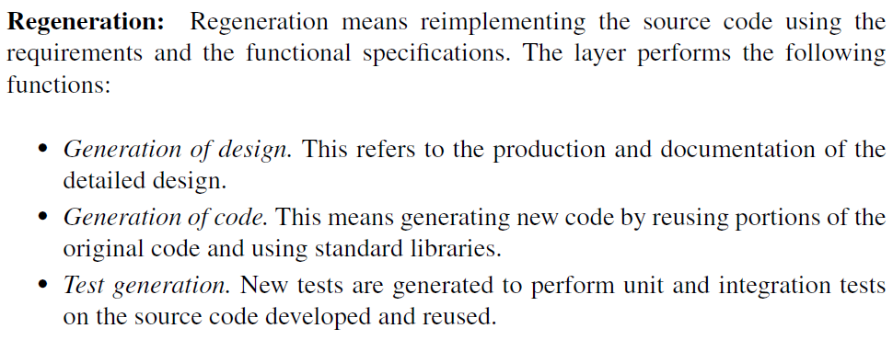
Regeneration

Slide 26
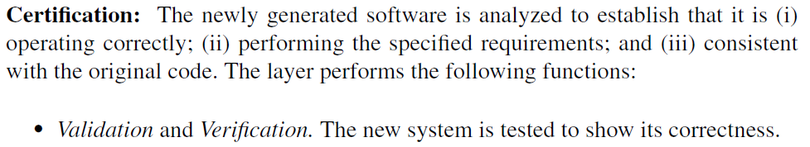
Certification

Slide 27
Conformance
Conformance. Tests are performed to show that the renovated source code performs at the minimum all those functionalities that were performed by the original source code.

